Slide 1

Music Recommendation System
Amity Institute of Information Technology
Submitted by:- Akshay Sharma
Enrolment no.: A50500718003
Dr. Charu Jain
Assistant Professor
CSE Department
Ms. Aarti Chugh
Assistant Professor
CSE Department

Slide 2
Topics
Introduction
Background study
Methodology
Result
Conclusion and future scope
References

Slide 3
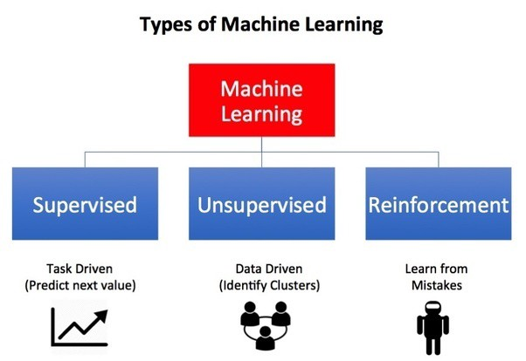
Machine Learning
Machine learning is an application of artificial intelligence (AI) that provides systems the ability to automatically learn and improve from experience without being explicitly programmed.
Machine learning focuses on the development of computer programs that can access data and use it to learn for themselves.

Slide 4
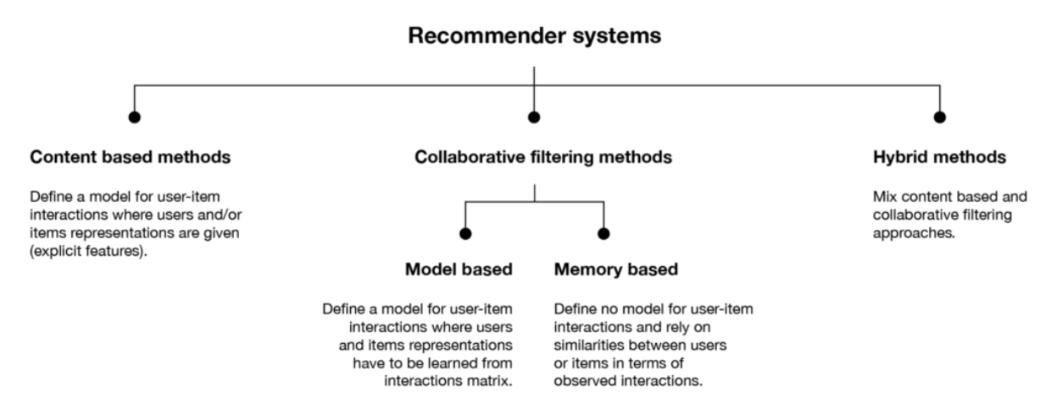
Music Recommendation
Music recommender system, the music provider can predict and then offer the appropriate songs to their users based on the characteristics of the music that has been heard previously.

Slide 5
Aim and objective
This aims to find the various songs so that we can recommend according to user’s taste.
To stop big tech companies sales the search data of users and their personalized song lists which is completely available on their websites.
The main objective in terms of outcome was to create a program for users which can help them suggesting the right songs for them.
This project is to reduce the time that user generally wastes on looking for the right song.

Slide 6
Recommendation Background Study
Similar home listings (Airbnb, Zillow)
Relevant media, e.g., photos, videos and stories (Instagram)
Relevant series and movies (Netflix, Amazon Prime Video)
Relevant songs and podcasts (Spotify)
Relevant videos (YouTube)
Similar users, posts (LinkedIn, Twitter, Instagram)
Relevant dishes and restaurants (Uber Eats)

Slide 7
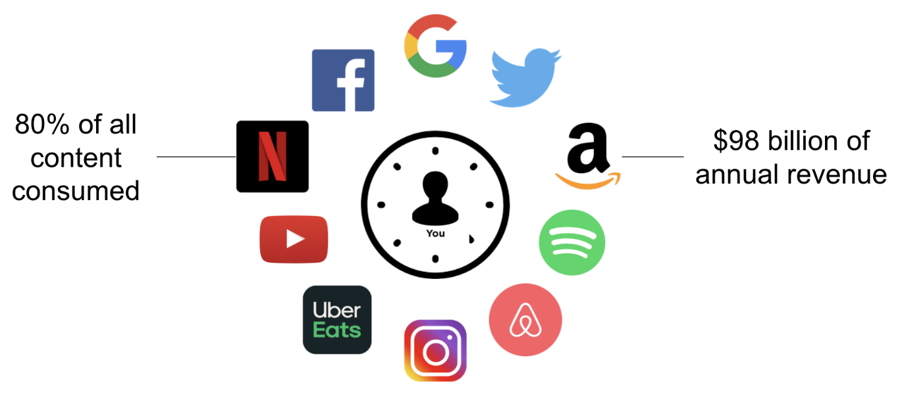

Slide 8
S.no. | Application Domain | Filtering Approach used | Related Research papers
1 | E-government | Collaborative Collaborative, hybrid | Guo and Lu (2007) Wu et al. (2015) and Lu et al. (2010)
2 | E-library and E-learning | Collaborative, hybrid | Cobos et al. (2013), Santos et al. (2014)
3 | E-tourism | Knowledge-based, collaborative Content-based, Collaborative | Ruotsalo et al (2013), Console et al. (2013) Xie et al. (2013)
4 | E-Resources | Content-based Collaborative | Jinni (2017), Rotten tomatoes (2017), IMDB (2017), ACRnews (2017) FoxTnt (2017), Tastekid (2017), nano Crowd (2017), Movielens (2017)

Slide 9
Advantages and disadvantages
Content-based Advantages | Content-based Disadvantages
The model doesn't need any data about other users, since the recommendations are specific to this user. This makes it easier to scale to a large number of users. | Since the feature representation of the items are hand-engineered to some extent, this technique requires a lot of domain knowledge. Therefore, the model can only be as good as the hand-engineered features.
The model can capture the specific interests of a user, and can recommend niche items that very few other users are interested in. | The model can only make recommendations based on existing interests of the user. In other words, the model has limited ability to expand on the users' existing interests.
Collaborative Advantages | Collaborative Disadvantages
We don't need domain knowledge because the embeddings are automatically learned. | Cannot handle fresh items
The model can help users discover new interests. In isolation, the ML system may not know the user is interested in a given item, but the model might still recommend it because similar users are interested in that item. | Hard to include side features for query/item

Slide 10
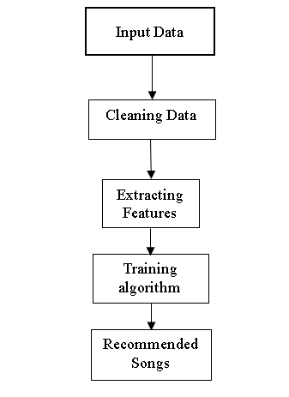
Proposed model Framework

Slide 11
Dataset
I have taken database from Kaggle https://www.kaggle.com/yamaerenay/spotify-dataset-19212020-160k-tracks?select=data.csv.
It contains massive (174389,19) data.
In this we have two datasets with name data.csv, data_w_genres.csv.
It contains different verity of data such as acousticness, artists, danceability, duration, energy, explicit, id, instrumentals, key, liveness, mode , popularity, speechiness, tempo, valence, genres, year ,Loudness, tempo.
But important dataset that we use in our program are genres, popularity, id , name.

Slide 12
Data cleaning
We convert genres from string to list.
Now dropping all columns from data_w_generes except id, generes_udp (in this coulumwe put generes all together).
Dropping duplicate dataset.
Dropping data having 0 popularity and dividing the popularity by 10.
Reducing dataset from 158k to less then 5k because we can’t process this big data.

Slide 13
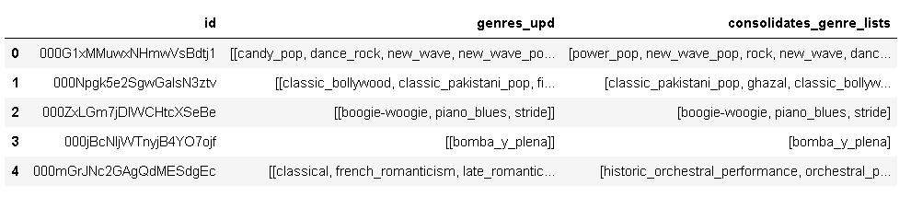
Feature Extraction
We use TF-IDF (Term Frequency Inverse Document Frequency) for genres in Content-based recommendation engine so that we can convert each word to feature index in the matrix so that each token gets a feature index.
In Collaborative filtering we extract popularity of song from database.

Slide 14
Algorithm Implementation
In this project we use KNN (k Nearest Neighbour )algorithm.
K-nearest neighbor finds the k most similar items to a particular instance based on a given distance metric.
In classification problems to predict the label of a instance we first find k closest instances to the given one based on the distance metric.
In an unsupervised setting such as this context we can simply find the neighbors and use them to recommend similar items.
In KNN we use Cosine similarity, Manhattan and Euclidian distance algorithm.

Slide 15
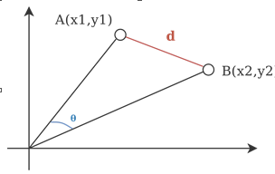

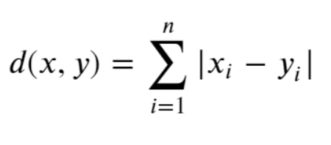
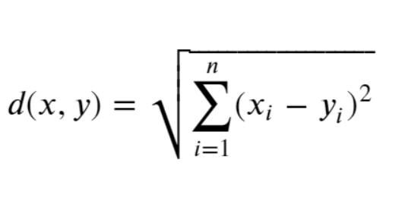
Comparison between Cosine, Manhattan, Euclidean distance
Cosine | Manhattan | Euclidean
In this we have to find the angle between lines. | It is based on Pythagoras theorem but consider base and height. | It is based on Pythagoras theorem but consider hypotonus.
In this we have cosine similarity and cosine distance. | It is called as L1 norms because of Minkowski Distance p value | It is called as L2 norms because of Minkowski Distance p value

Slide 16
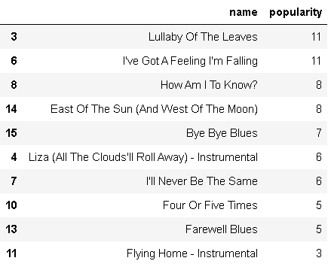
Results
To get recommendation we need to search song and according to get the recommend songs.
Content based filtering - Genres Based(KNN Cosine Similarity)

Slide 17
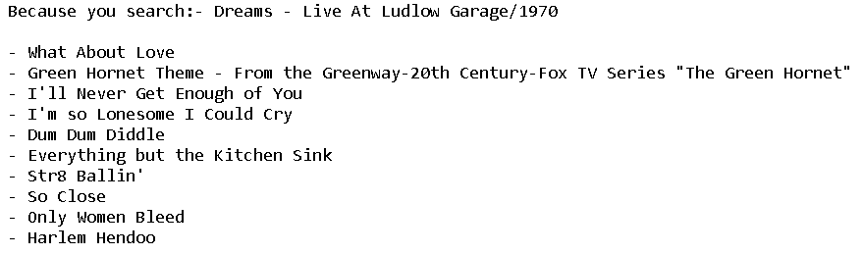
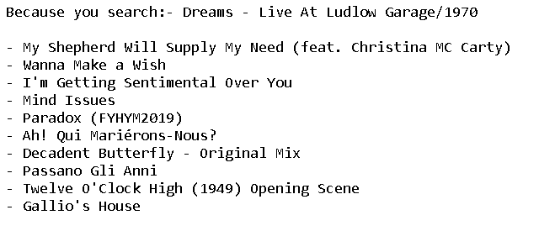
Collaborative based filtering using Cosine Similarity based on popularity.
Collaborative based filtering using Euclidean distance based on popularity.

Slide 18
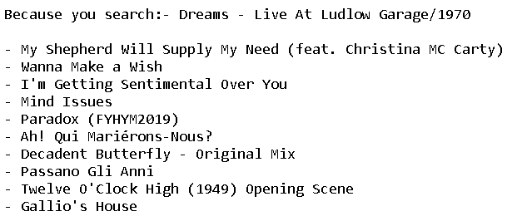
Collaborative based filtering using Manhattan distance based on popularity.

Slide 19
Future Scope
We can create a platform for commercial purpose using Spotify API and apple API.
With recommendation we can provide editing, creating song list.

Slide 20
References
https://www.kaggle.com/yamaerenay/spotify-dataset-19212020-160k-tracks?select=data.csv
https://expertsystem.com/machine-learning-definition/
https://www.datarobot.com/wiki/prediction/#:~:text=What%20does%20Prediction%20mean%20in,will%20churn%20in%2030%20days.
https://www.researchgate.net/publication/339172772_Recommender_Systems_An_Overview_Research_Trends_and_Future_Directions
https://buffer.com/library/social-media-sites/
https://towardsdatascience.com/recommender-systems-the-most-valuable-application-of-machine-learning-part-1-f96ecbc4b7f5
https://www.marketsandmarkets.com/Market-Reports/recommendation-engine- market-151385035.html
https://colab.research.google.com/noteboo
https://www.bluepiit.com/blog/classifying-recommender-systems/
https://www.sciencedirect.com/topics/computer-science/cosine-similarity
https://medium.com/recombee-blog/machine-learning-for-recommender-systems-part-1-algorithms-evaluation-and-cold-start-6f696683d0ed

Slide 21


